Slide 1
Data Visualization of Bird Strikes between 2000 – 2011
Submitted by:
Chandan Bhattacharya

Slide 2
Problem Statement
The problem revolves around the analysis of bird strikes, defined as collisions between birds and aircraft during flight, take-off, or landing. Bird strikes pose a significant threat to aircraft safety, potentially causing structural damage and engine failures, leading to fatal accidents. The analysis focuses on data collected by the FAA between 2000-2011. Key aspects include visualizing the number of bird strikes, yearly analysis, top airlines and airports affected, cost incurred, timing and altitude of strikes, flight phase during strikes, impact on flight, and the relation between pilot warnings and strike effects.

Slide 3
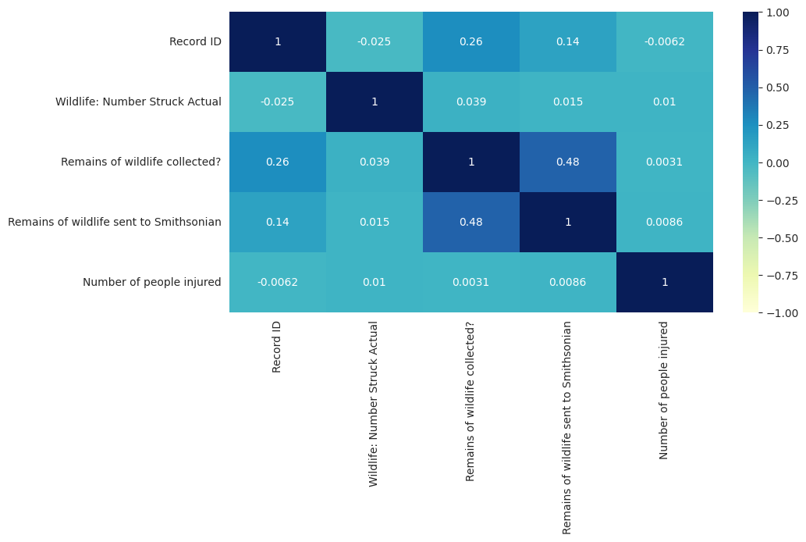
Creating DataFrame for Checking the Correlation

Slide 4
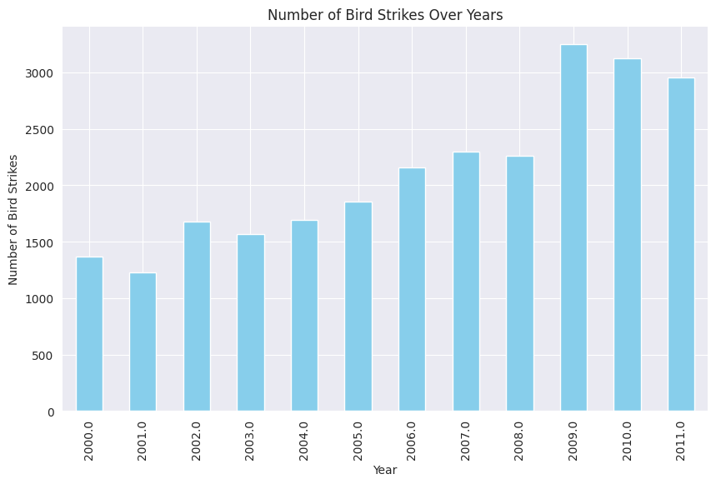
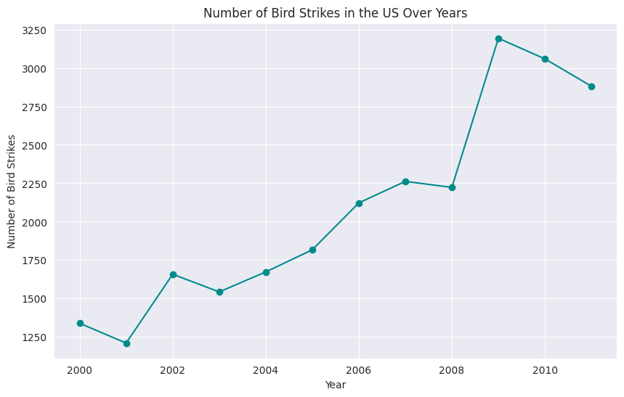
Bird Strikes Over Years
Data Visualization of Bird Strikes between 2000 – 2011

Slide 5
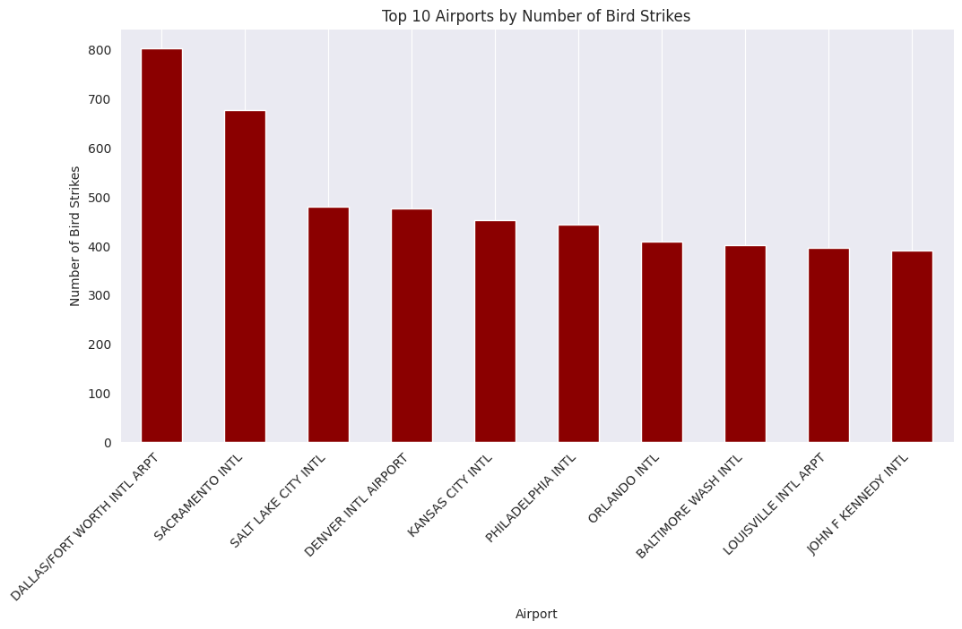
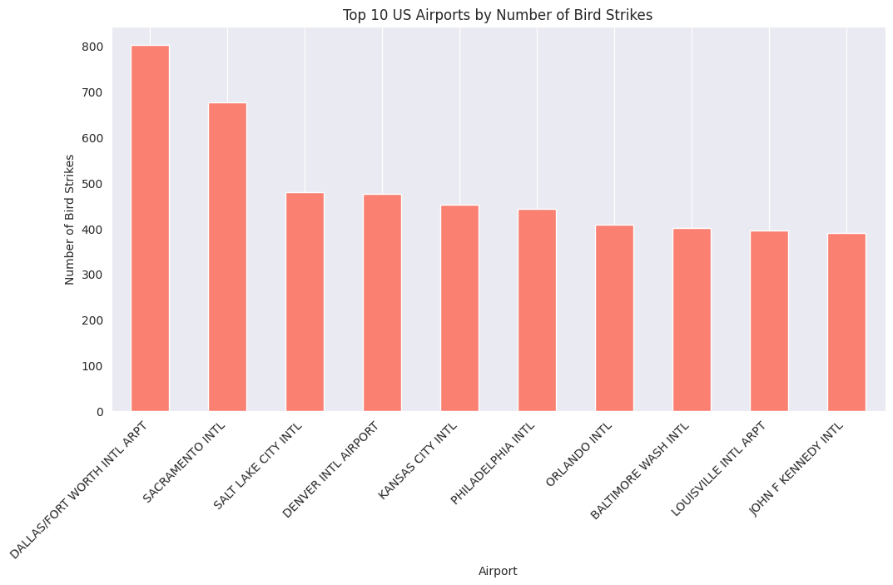
Top 10 Airports by Number of Bird Strikes
Data Visualization of Bird Strikes between 2000 – 2011

Slide 6
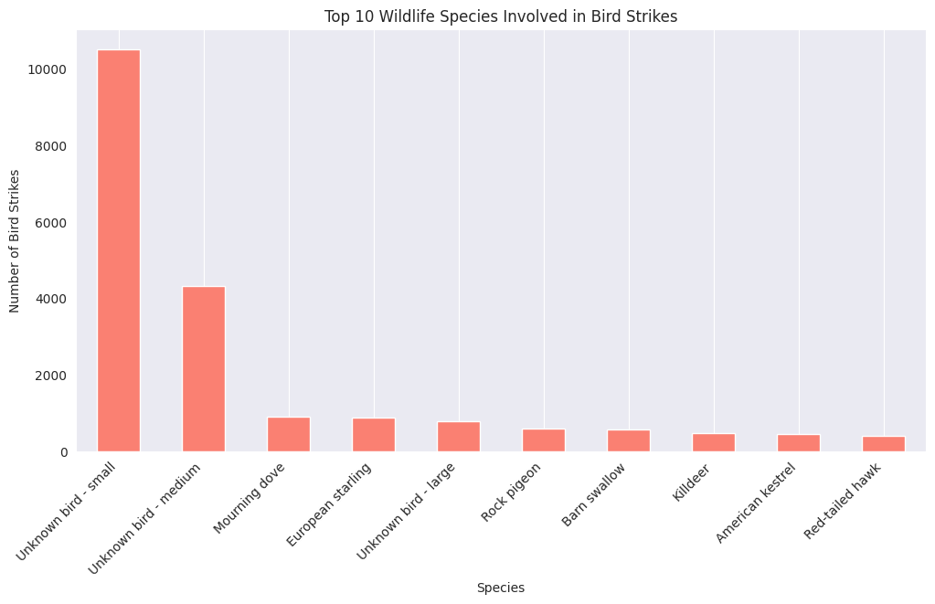
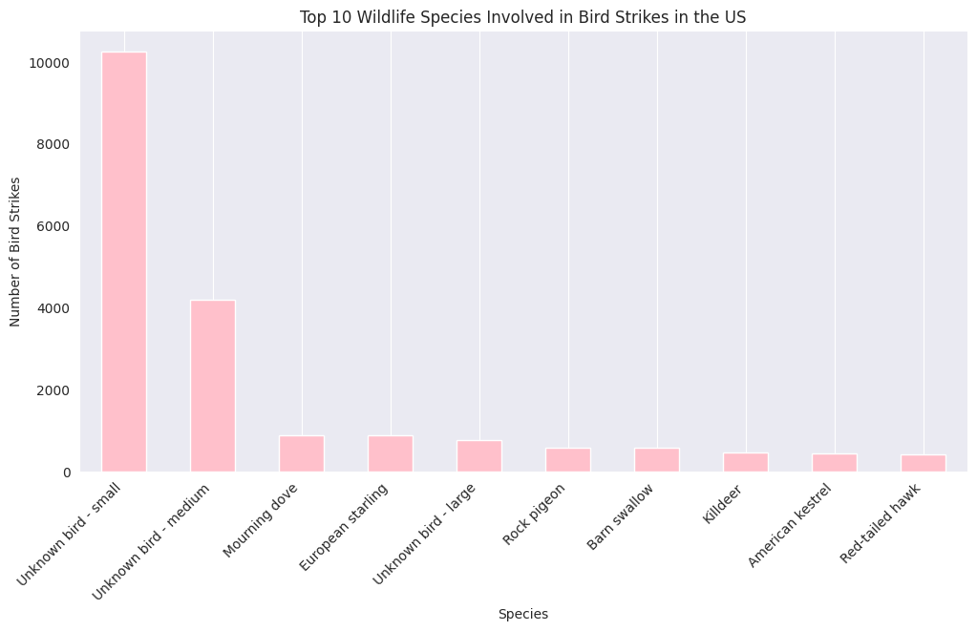
Top 10 Wildlife Species Involved in Bird Strikes
Data Visualization of Bird Strikes between 2000 – 2011

Slide 7
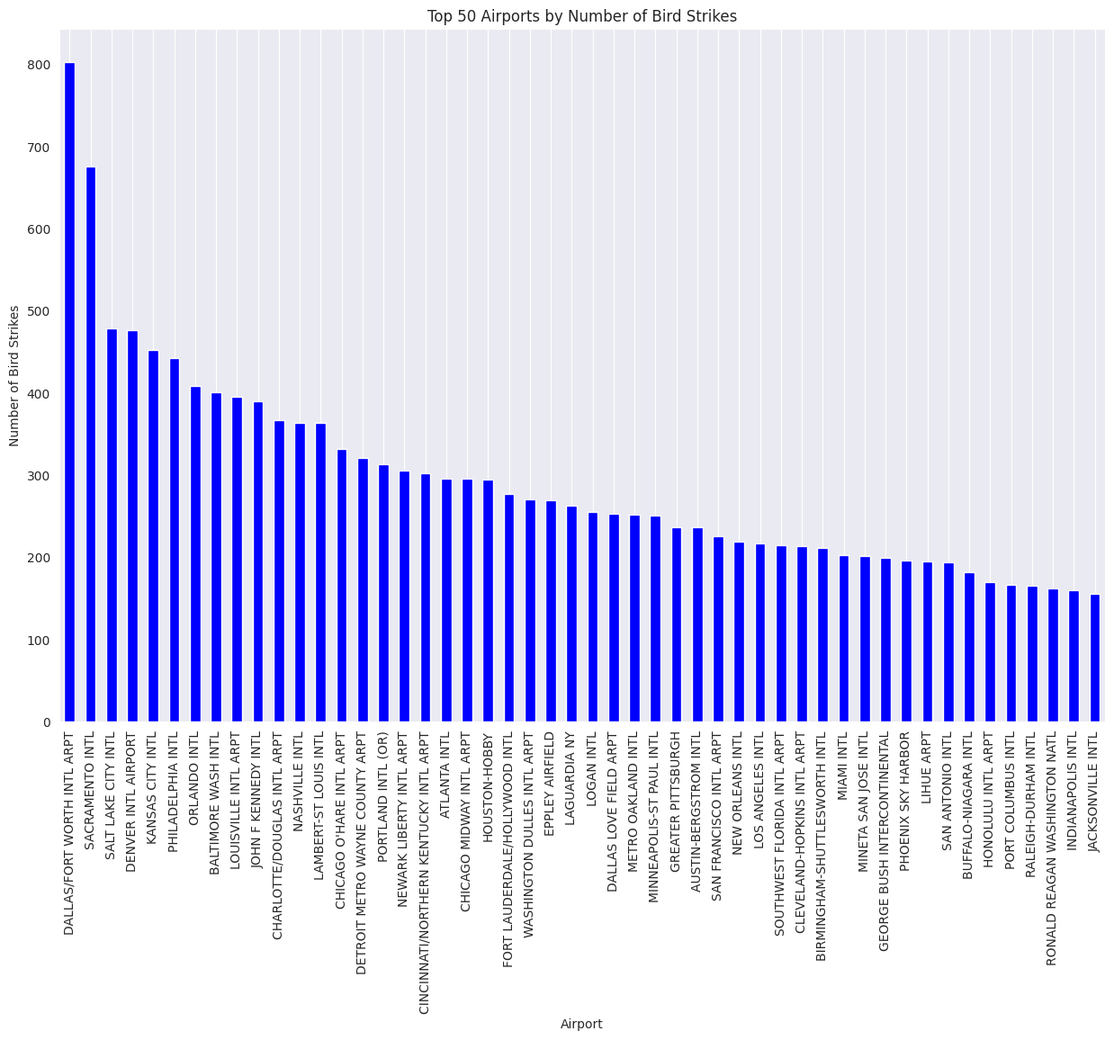
Top 50 Airports by Number of Bird Strikes
Data Visualization of Bird Strikes between 2000 – 2011

Slide 8
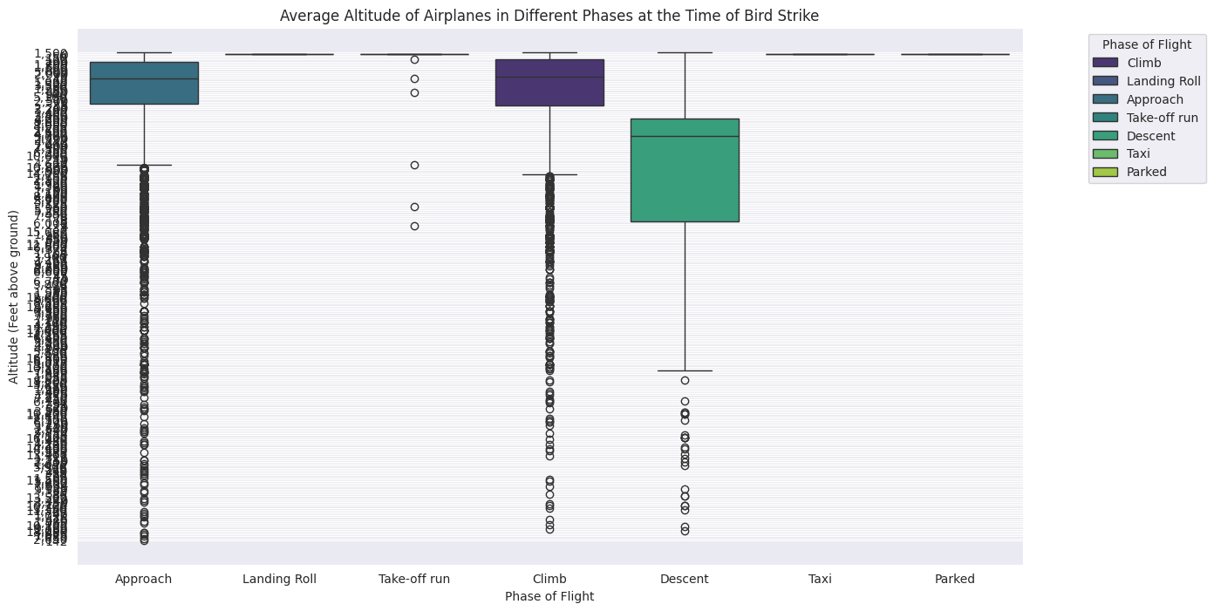
The Timing of Bird Strikes During Different Phases of Flight
Data Visualization of Bird Strikes between 2000 – 2011

Slide 9
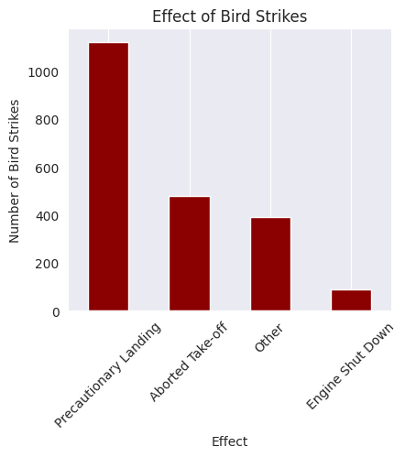
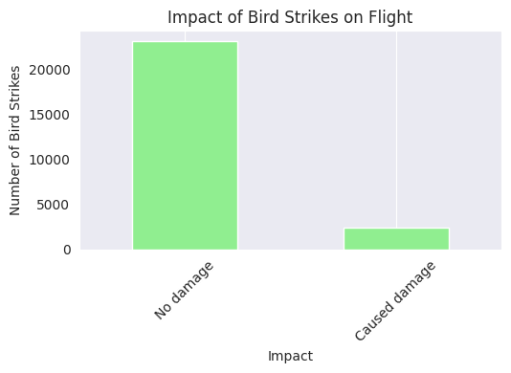
The Effects and The Impacts of Bird Strikes on Flight
Data Visualization of Bird Strikes between 2000 – 2011

Slide 10
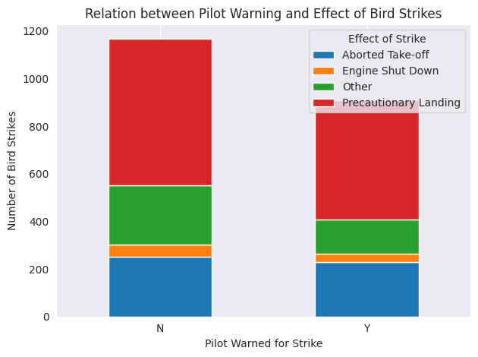
Relation between Pilot Warning and Effect of Bird Strikes
Data Visualization of Bird Strikes between 2000 – 2011

Slide 11
Main KPIs
Key Performance Indicators (KPIs) are metrics used to evaluate the performance and effectiveness of a particular process or activity. In the context of analyzing bird strikes, several KPIs can be identified based on the problem statement provided:
Number of Bird Strikes
Yearly Cost Incurred due to Bird Strikes
Top 10 US Airlines by Bird Strike Encounters
Airports with Most Incidents of Bird Strikes
Timing of Bird Strikes
Altitude of Airplanes at Time of Strike
Phase of Flight at Time of Strike
Effect of Bird Strikes & Impact on Flight
Effect of Strike at Different Altitude
Pilot Warning and Effect of Strike Relation

Slide 12
Thank you

